Slide 1

Travel agent
AICTE PROJECT
Presented By:
Student name : Mohana Sri Premnath
College Name & Department : IIT Madras , Data Science and Applications

Slide 2
Outline
Problem Statement
Technology used
Wow factor
End users
Result
Conclusion
Git-hub Link
Future scope
IBM Certifications

Slide 3

Problem Statement
Researchers, students, and professionals often struggle to stay updated with the rapidly growing volume of academic publications, technical articles, datasets, and evolving research trends. Manually reviewing, filtering, and synthesizing information across multiple domains is time-consuming and inefficient.
Proposed Solution: An AI Research Agent that uses Natural Language Processing (NLP), Retrieval-Augmented Generation (RAG), to assist users in conducting efficient literature reviews, generating summaries, identifying research gaps, and recommending relevant papers, datasets, or collaborators.

Slide 4
Technology used
IBM cloud lite services
Natural Language Processing (NLP)
Retrieval Augmented Generation (RAG)
IBM Granite model

Slide 5
IBM cloud services used
IBM Cloud Watsonx.ai Studio
IBM Cloud Watsonx.ai runtime
IBM Cloud Agent Lab
IBM Granite foundation model

Slide 6
Wow factors
This agent will significantly reduce research time, improve the quality of literature reviews, help early-stage researchers find direction, and foster interdisciplinary collaboration by making knowledge more accessible and actionable.
Unique features:
Semantic search across research papers, journals, and datasets
Auto-summarization of selected papers
Citation and reference analysis to trace influence
Recommendation of research papers based on a user’s current topic
Trend analysis over time for specific keywords or domains.
Collaboration mapping: suggests potential co-authors or institutions based on similar research interests.

Slide 7
End users
Academic Researchers
Research Institutions and Universities
Industry R&D Teams
Educators

Slide 8
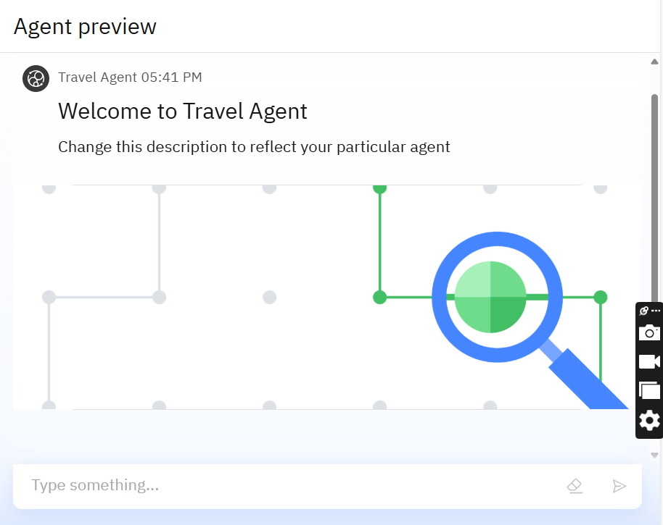
Results

Slide 9

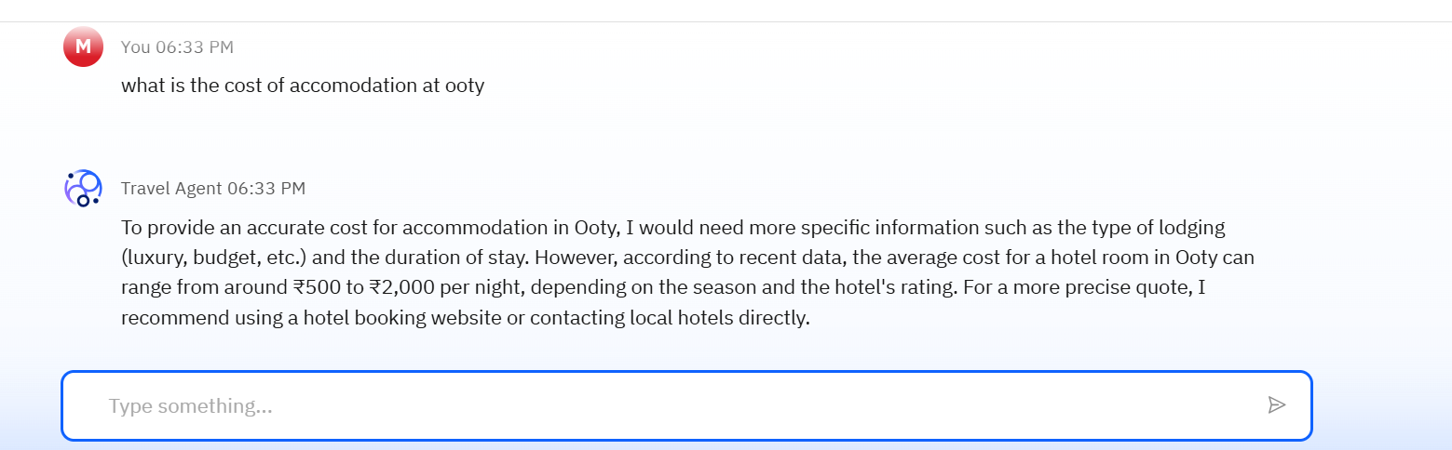
Results

Slide 10
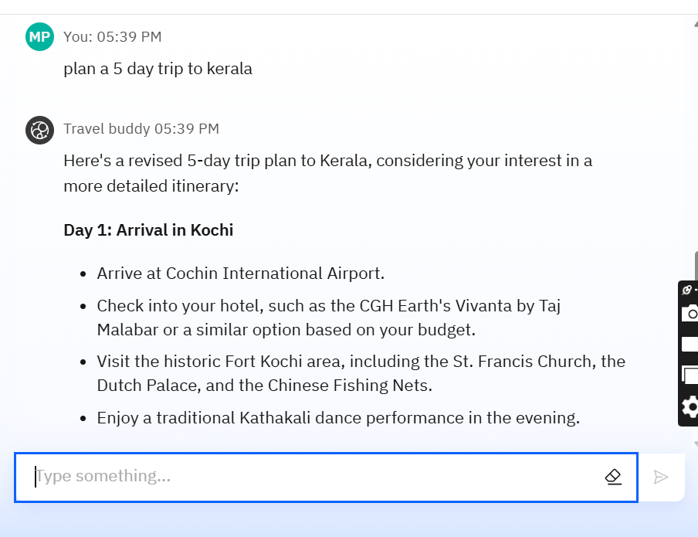
Results

Slide 11
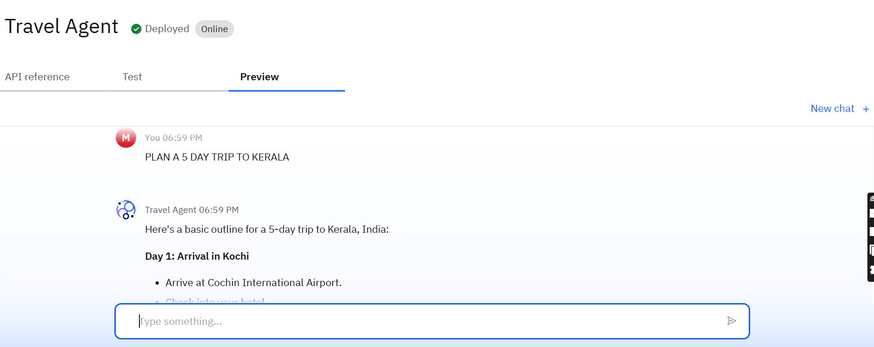
Results
Deployed AI Agent

Slide 12
Conclusion
The agent can generate reports, suggest hypotheses, and even draft sections of research papers.
It saves time by automating repetitive tasks like citation management and data extraction.
Research Agents enhance efficiency, accuracy, and innovation in both academic and industrial R&D.

Slide 13
Future Scope
Multilingual Research Support
Voice-Activated Research Assistant
Real-Time Collaboration Features
Research Gap and Novel Topic Identification
Integration with Publishing Platforms
AI-Assisted Paper Drafting

Slide 14
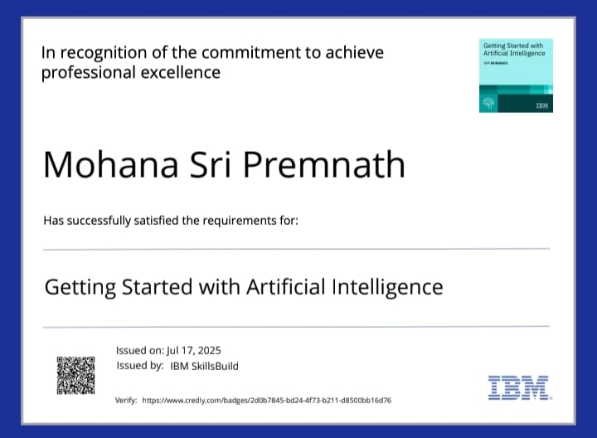
IBM Certifications

Slide 15
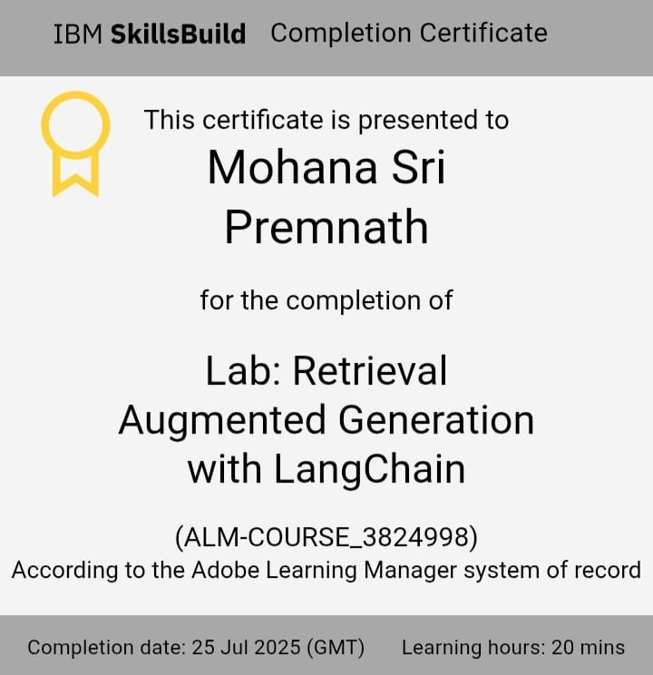
Rag Certificate

Slide 16
GitHub Link
https://github.com/Mohana-Sri-Premnath2006

Slide 17
THANK YOU

